Slide 1
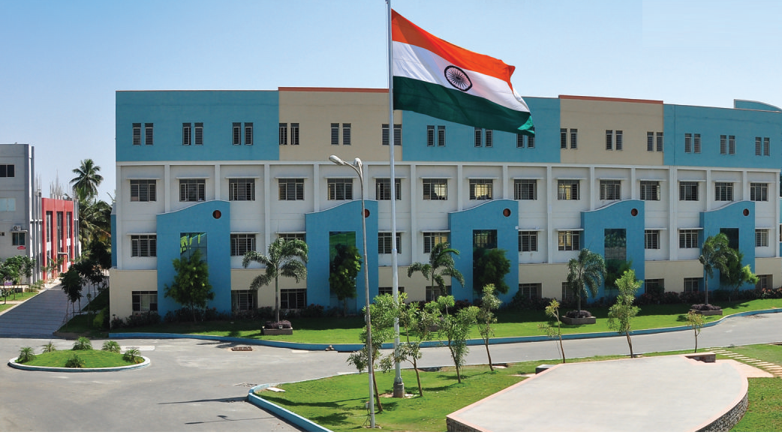
SRI ESHWAR COLLEGE OF ENGINEERING academic year : 2017-2018 department: civil engg
FINAL YEAR (first REVIEW )
Date of review: 07.10.17

Slide 2
PLANNING ,DESIGNING,ANALYSIS OF INDUSTRIAL BULIDINGS
Batch Members
1 Guhan R V
2 Jaya Surya
3 Suryakumar O R
Guide Name:
Mr.R.Srinivas Prabhu
Asst.Prof/CIVIL Dept.

Slide 3
PRESENTATION OUTLINE
Title
Description
Abstract
Need for study
Abstract
Literature Survey
Objective
Study area
Methodology
Plan
Analysis
Design
Result and destination

Slide 4
ABSTRACT OF THE PROJECT
The proposed Industry building can be used for multi purpose manufacturing building
As the steel roof covers the maximum volumes with no interrupting columns with more efficient manner.
In this project the analysis of steel roof is examine by using STAAD Pro.

Slide 5
NEED FOR THE STUDY
We Referred many Journals for designing many parts in steel structures especially Roof truss structure.
Designing of Connections in Steel Structures.

Slide 6
Objective
To provide car manufacturing industry in Coimbatore, we are going to develop a industry building using steel roof structure.
To provide a comfort zone

Slide 7
Literature Survey
JOURNAL | Indian Institute of Technology Madras
TITLE | Design of Steel Structures
AUTHOR(S) | Prof. S.R.Satish Kumar and Prof. A.R.Santha Kumar
INFERENCE | The industrial buildings are constructed with adequate headroom for the use of an overhead traveling crane. Special types of industrial buildings like steel mill buildings are used for manufacture of heavy machines, production of power etc.

Slide 8
Literature Survey (Cont’d..)
JOURNAL | Konstantin Papkovskiy
TITLE | THE DESIGN OF AN INDUSTRIAL BUILDING ACCORDING TO RUSSIAN AND EUROPEAN CONSTRUCTION NORMS
AUTHOR(S) | Mr. Pekka Timonen, Mr. Petri Himmi.
INFERENCE | The design of a typical industrial building is considered in this work. The dimensioning of steel truss members and foundations and the calculation of column longitudinal reinforcement area are discussed.

Slide 9
Literature Survey (Cont’d..)
JOURNAL | IOSR Journal of Mechanical and Civil Engineering (IOSR-JMCE)
TITLE | Comparative Study of Analysis and Design of Pre-Engineered- Buildings and Conventional Frames
AUTHOR(S) | Aijaz Ahmad Zende1, Prof. A. V. Kulkarni 2, Aslam Hutagi
INFERENCE | Saving of material on low stress area of the primary framing members makes Pre engineered buildings more economical than Conventional steel buildings especially for low rise buildings spanning up to 90.0 meters with eave heights up to 30.0 meters.

Slide 10
Literature Survey (Cont’d..)
JOURNAL | IOSR Journal of Business and Management (IOSR-JBM)
TITLE | Product and Brand Building Strategies – A Study Of Hyundai Motors
AUTHOR(S) | Dr. Anitha Thimmaiah
INFERENCE | As Hyundai Company is one of the reputed automobile company in India which has occupied second place in the market share of automobile companies, this paper tries to study the product and the brand building strategies of the Hyundai Company in India.

Slide 11
Literature Survey (Cont’d..)
JOURNAL | International Refereed Journal of Engineering and Science (IRJES)
TITLE | Building Design Using Cold Formed Steel Section
AUTHOR(S) | Mr. Roshan S Satpute, Dr. Valsson Varghese M.Tech (Structural Engineering) Karmaveer Dadasaheb Kannamwar College
INFERENCE | In Industrial building the material & cost of the building is minimized in case of cold formed steel while in case of conventional building it was be higher both in two cases. The saving in material and cost is about 25 %. .

Slide 12
METHODLOGY
Selection of Title
Collection Literature Survey
Planning using Auto Cad
Analysis & Design Using STAAD Pro.
Result and conclusion

Slide 13
Conclusion
We have planned for the area of 18560 ft square successfully using Auto Cad.
Analysis was successfully completed using Staad Pro. Deflection, Shear, bending was found.
In all aspects the building was safe under all circumference.

